Slide 1
Presentation for Minister of Veterans Affairs Mental Health Advisory Group
CAF / VAC Joint Suicide Prevention Strategy
April 12, 2018
Alexandra Heber MD FRCPC CCPE
Chief Psychiatrist,
Veterans Affairs Canada

Slide 2
For additional
information visit
our website at:
https://www.canada.ca/content/dam/dnd-mdn/documents/reports/ 2017/ caf-vac-joint-suicide-prevention-strategy.pdf

Slide 3
Building Blocks of the Suicide Prevention Strategy

Slide 4
Framework for Action

Slide 5
The Suicide Prevention Continuum (as described in the Federal Framework for Suicide Prevention)
The 2 Departments will organize their efforts along the Suicide Prevention Continuum as follows:
Prevention: Actions to prevent suicidality such as programs and interventions to support Veterans’ health and well-being, financial help, research, education, family support
Intervention: Actions when a Veteran becomes suicidal, such as screening, treatment and support for those with suicidal thoughts and behavior, eg close follow-up on hospital discharge
Postvention: Actions taken in the aftermath of suicide, eg QA reviews, providing support to family and other survivors, media engagement

Slide 6
The Suicide Prevention Continuum
PREVENTION
POSTVENTION
INTERVENTION

Slide 8
FFSP : likelihood of suicidality or completed suicide may increase or decrease due to complex interplay of risk and protective factors
From this, CAF and VAC have based joint strategy and Lines of Effort on targeting our efforts and interventions to have biggest impact
“Upstream” efforts in keeping with:
Determinants of well-being (VAC)
Total health and wellness strategy (CAF)

Slide 9
Determinants of Well-Being
Domains of Well-Being | Determinants of Well-Being (Examples) | Descriptors of Well-Being (Examples)
Employment or other activity | Workplace environment, Economy, Job preparation | Engaged in activities that are beneficial and meaningful to them
Finances | Income, Financial planning, Financial support programs | Financially secure
Health | All the determinants of health (see WHO and PHAC lists) | Functioning well physically, mentally, socially and spiritually
Life Skills | Identity counselling, Resiliency training, Financial management training | Able to adapt, manage and cope in military and civilian life
Social Integration | Social services, Family services, Social support networks, Community services | In mutually supportive social relationships and engaged in their community
Housing (Physical environment) | Home financing, Housing, shelter | Living in safe and stable housing
Culture | Customs and traditions, Beliefs, CAF and VAC Recognition Activities | Understood and valued by Canadians

Slide 10
CAF / VAC Joint Strategic Framework
Purpose: to provide a framework for a comprehensive approach to suicide prevention that provides common guiding principles and directs appropriate coordination for the CAF and VAC.
The Framework provides:
The Framework accounts
for differences in:
Shared Purpose;
Common Guiding Principles;
Mutual Strategic Lines of Effort;
Guidance on Managing the Transition from CAF member to Civilian (Veteran);
Alignment with GoC Initiatives on SP and MH.
Legislative mandates and regulations;
Distinctive populations;
Unique needs of CAF Members & Veterans;
Separate systems of mental health care and support.

Slide 11
One Overarching Strategic Framework Two Action Plans…. Joint Military-Civilian Transition

Slide 12
TAKING
ACTION

Slide 13
VAC Suicide Prevention Strategy Action Plan (SPS AP)
All programs and initiatives are based on the Determinants of Well-Being, as they affect Veterans and their families;
Action Plan items are the result of: Review of the scientific literature; Internal and external consultations (including with Veteran stakeholder groups); File reviews of Veterans who died by suicide; Participation in activities such as the 2016 Mental Health Expert Panel on Suicide Prevention in the Canadian Armed Forces;
Action Plan items organized within the 7 Lines of Effort of the SPS
VAC SPS AP identifies approximately 68 Action Plan Items associated with suicide prevention; and
VAC SPS AP includes approximately 24 Items related to the Military to Civilian Transition, most of which are coordinated with the CAF.
/15

Slide 14
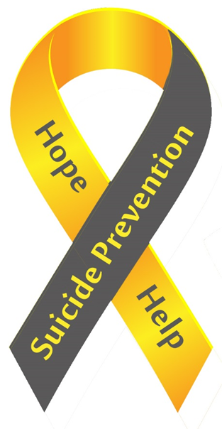
LINES
OF
EFFORT
CAF / VAC
JOINT
SUICIDE
PREVENTION
STATEGY

Slide 15
Currently Exploring…

Slide 16
To learn about and to leverage technology for more effective interventions
Collaborative
research
with DND and
Statscan on
Veteran suicide
Women Veterans and suicide
Exploring
emerging
treatments to target
suicidality
Notes:
•

Slide 17
Updates on the Action Plan (see handout)

Slide 18
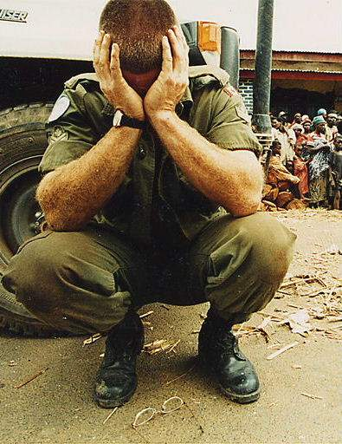
Thank-you
QUESTIONS?
Anonymous Canadian soldier Rwanda 1994

